Slide 1
Unit Testing
21 November 2018
Pavel Kryukov

Slide 2
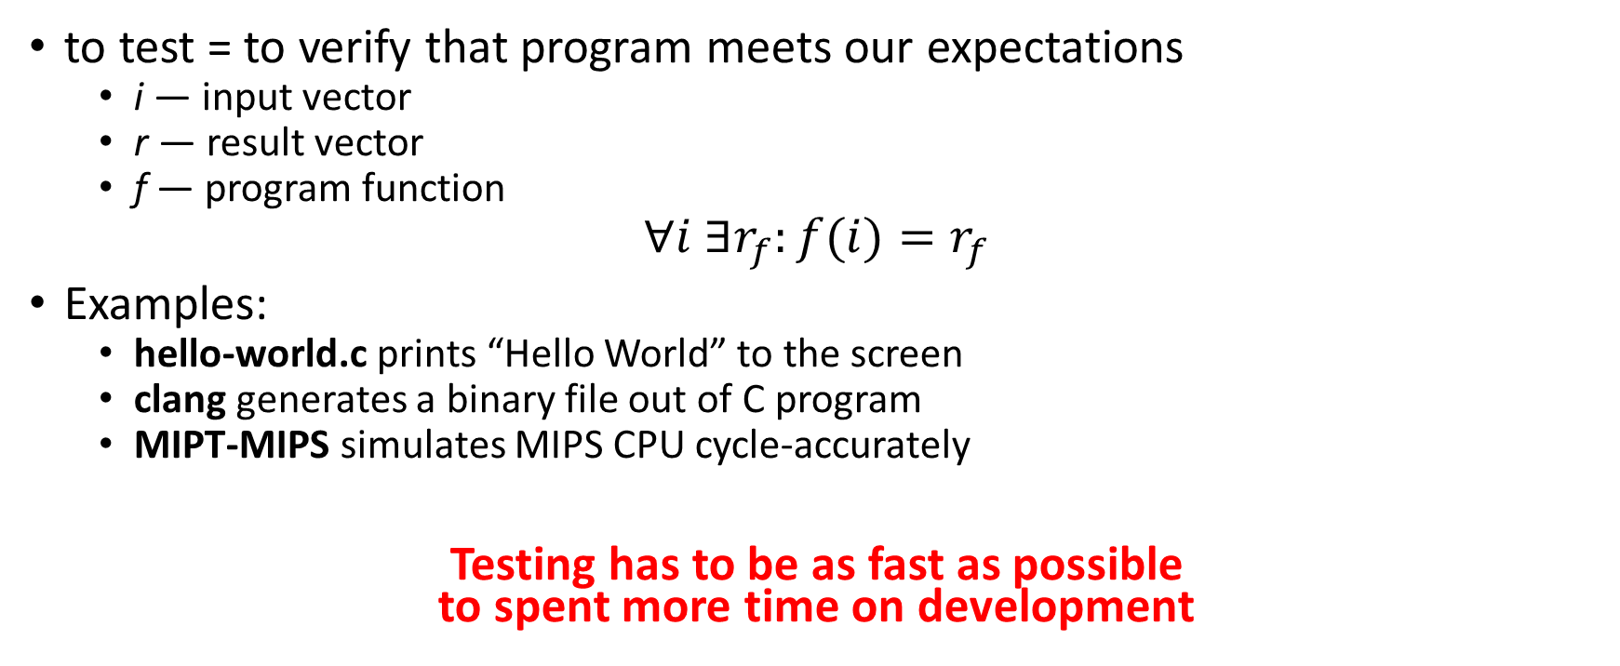
What is testing?
to test = to verify that program meets our expectations
i — input vector
r — result vector
f — program function
$$∀i ∃r_{f}:f(i){=r}_{f}$$
Examples:
hello-world.c prints “Hello World” to the screen
clang generates a binary file out of C program
MIPT-MIPS simulates MIPS CPU cycle-accurately
Testing has to be as fast as possible to spent more time on development

Slide 3
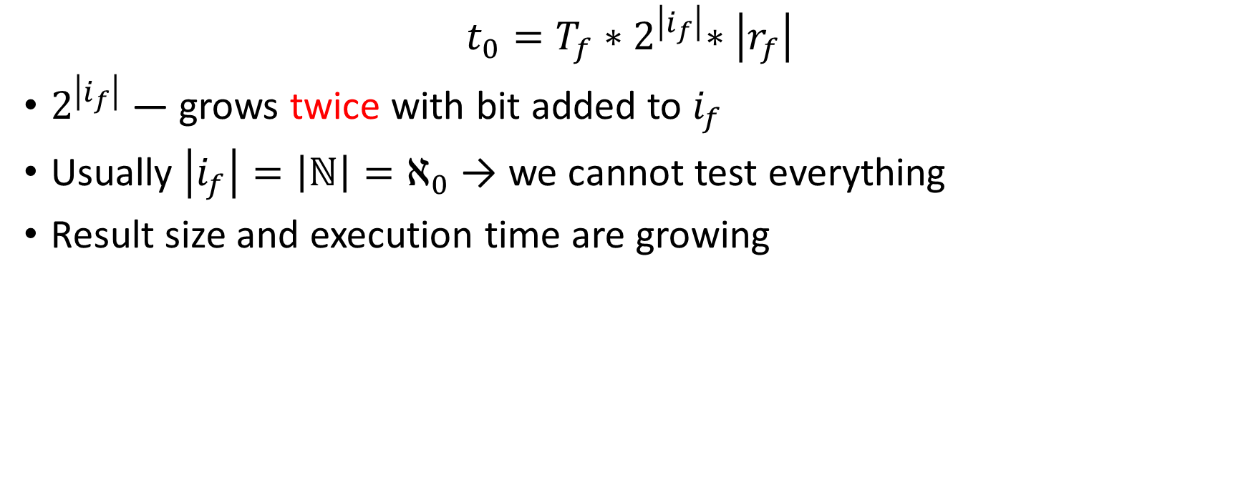
Test timing
$$t_{0}=T_{f}{∗2}^{\left|i_{f}\right|}∗\left|r_{f}\right|$$
$2^{\left|i_{f}\right|}$ — grows twice with bit added to $i_{f}$
Usually $\left|i_{f}\right|=\left|ℕ\right|{=ℵ}_{0}$ → we cannot test everything
Result size and execution time are growing

Slide 4
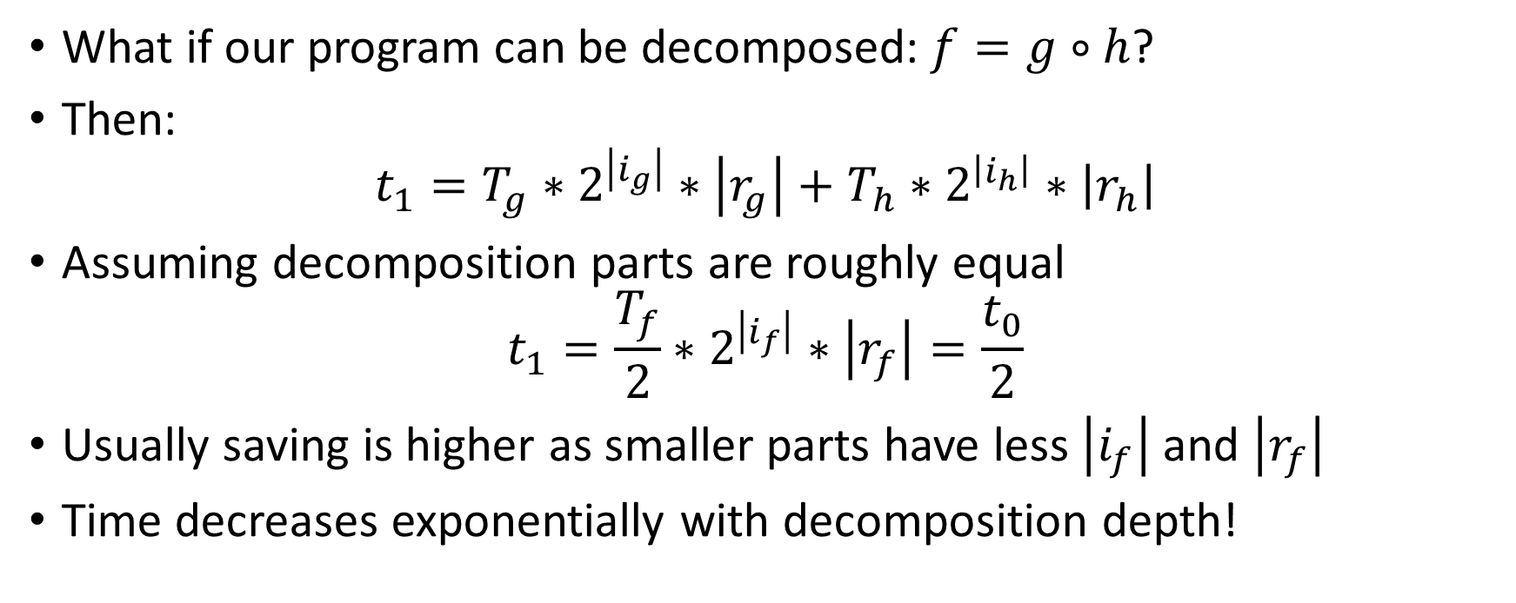
Advantage of decomposition
What if our program can be decomposed:$f=g∘h$?
Then:
$$t_{1}=T_{g}∗2^{\left|i_{g}\right|}∗\left|r_{g}\right|+T_{h}∗2^{\left|i_{h}\right|}∗\left|r_{h}\right|$$
Assuming decomposition parts are roughly equal
$$t_{1}=\frac{T_{f}}{2}∗2^{\left|i_{f}\right|}∗\left|r_{f}\right|=\frac{t_{0}}{2}$$
Usually saving is higher as smaller parts have less $\left|i_{f}\right|$ and $\left|r_{f}\right|$
Time decreases exponentially with decomposition depth!

Slide 5
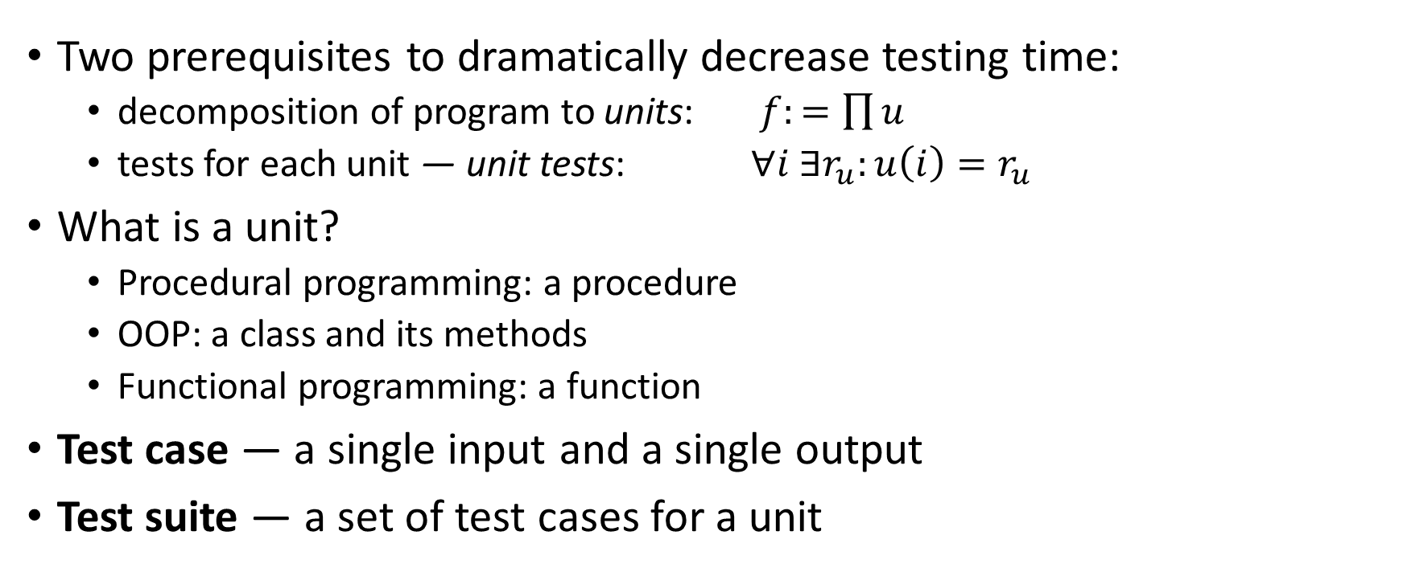
Units and unit tests
Two prerequisites to dramatically decrease testing time:
decomposition of program to units: $f:=\prod{u}$
tests for each unit — unit tests: $∀i ∃r_{u}:u\left(i\right)=r_{u}$
What is a unit?
Procedural programming: a procedure
OOP: a class and its methods
Functional programming: a function
Test case — a single input and a single output
Test suite — a set of test cases for a unit

Slide 6
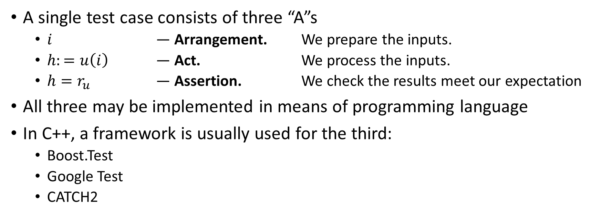
Three A rule
A single test case consists of three “A”s
$i$ — Arrangement. We prepare the inputs.
$h:=u\left(i\right)$ — Act. We process the inputs.
$h=r_{u}$ — Assertion. We check the results meet our expectation
All three may be implemented in means of programming language
In C++, a framework is usually used for the third:
Boost.Test
Google Test
CATCH2

Slide 7
CATCH2 framework example
#include <catch.hpp>
#include “divider.h”
TEST_CASE( “Divider” ) // Defines a single test case
{
// Arrange
Divider d;
d.numerator = 12;
d.denumerator = 6;
// Act
auto result = d.execute();
// Assert
CHECK( result == 2);
}

Slide 8
Failures may be tested as well
TEST_CASE( “Divider: divide by zero” )
{
// Arrange
Divider d;
d.numerator = 12;
d.denumerator = 0;
// Act + assert
CHECK_THROWS_AS( d.execute(), DivideByZero);
}

Slide 9
Test suite == Unit documentation
TEST_CASE( “Divider” ) {
Divider d;
d.numerator = 12;
d.denumerator = 6;
CHECK( 2 == d.execute());
}
TEST_CASE( “Divide by zero” ) {
Divider d;
d.numerator = 12;
d.denumerator = 0;
CHECK_THROWS_AS( d.execute(),
DivideByZero);
}
Do you need any more documentation for the “Divider” class?
Unlike comments, document files etc., unit tests always match the state-of-the-art code!

Slide 10
Encapsulation and refactoring
Unit tests do not care about class implementation
only interfaces must be tested
Benefits:
we may change implementation as long as tests pass
we can safely refactor or optimize the code
int Divider::execute() {
if (!denominator) throw DivideByZero();
int result = 0;
while (numerator > denominator) {
result++;
nominator -= denominator;
}
return result;
}
int Divider::execute() {
if (!denominator) throw DivideByZero();
return nominator / denominator;
}

Slide 11
Unit tests → structured code
Unit tests motivate writing structured code
Unit tests motivate keeping structured code
Structured code may be integrated separately
Actual for big projects

Slide 12
How to write unit tests
Clearly define interfaces of your unit
OK, what interfaces are?

Slide 13
Interfaces: three types
Initializing:
Generates a new unit
Ctors, Factories etc.
Accessing:
Do not mutate unit
Return value
“getters”, readers etc.
Mutating:
Change unit state
Usually do not return any value
“setters”, “processors” etc.
Interacting:
Change state of two units
Out of scope today
class Queue {
public:
// Initializing
Queue(size_t max_size) throws(std::bad_alloc);
// Accessing
size_t size() const;
size_t max_size() const;
bool empty() const;
int front() const throws(QueueEmpty);
int back() const throws(QueueEmpty)
// Mutating
void push() throws(QueueFull);
void pop() throws(QueueEmpty);
private:
// ...
};

Slide 14
How to write unit tests (2)
Clearly define interfaces of your unit
Test initializing methods: they should pass/fail when they have to:
CHECK_NOTHROW( Queue(0) );
CHECK_NOTHROW( Queue(2) );
CHECK_THROWS_AS( Queue(-1), std::bad_alloc);
Test accessing methods:
Queue q(0);
CHECK( q.empty());
CHECK( q.size() == 0);
CHECK( !q.full() );
CHECK_THROWS_AS( q.front(), QueueEmpty);
CHECK_THROWS_AS( q.back(), QueueEmpty);

Slide 15
How to write unit tests (3)
Test mutating methods, one by one
Queue q(2); // Arrange
q.push(10); // Act
// Assert
CHECK( !q.empty());
CHECK( q.size() == 1);
CHECK( !q.full() );
CHECK( q.front() == 10);
CHECK( q.back() == 10);

Slide 16
Unit testing: best known methods
Shortness
One test case — one “arrangement” and one “act” section
Bootstrap
next test cases uses “act” of previous case as “arrangement”
Accumulation
if you fix a bug, make a test case to prevent it happen again

Slide 17
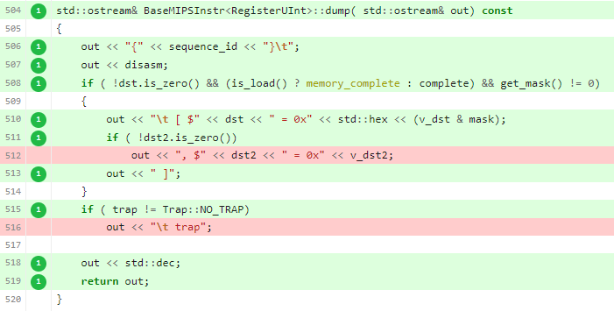
Test coverage
Test suite should be as full as possible
However, complete test suite is hardly achievable
Code coverage systems
show control flows never triggered by tests
Drawbacks
no guarantee that each control flow combination is possible
contradicts with “black box” concept

Slide 18
Known limitations
Probabilistic applications:
computational math
games
Physics-level applications:
network
timing
GUI input/output
sensors
Strategy: isolate non-testable units as much as possible

Slide 19
Teaser: TDD
So far, we go this way: f → {i}, {r}
But what if we go the opposite: {i}, {r} → f
Looks weird at the first glance
At the second glance, it matches how we do things in real life
Actually there are a lot of benefits — topic of the next lecture

Slide 20
Further reading
Wiki: https://github.com/MIPT-ILab/mipt-mips/wiki/Unit-Tests
CATCH2 tutorial: https://github.com/catchorg/Catch2/blob/master/docs/tutorial.md#top

